Slide 1
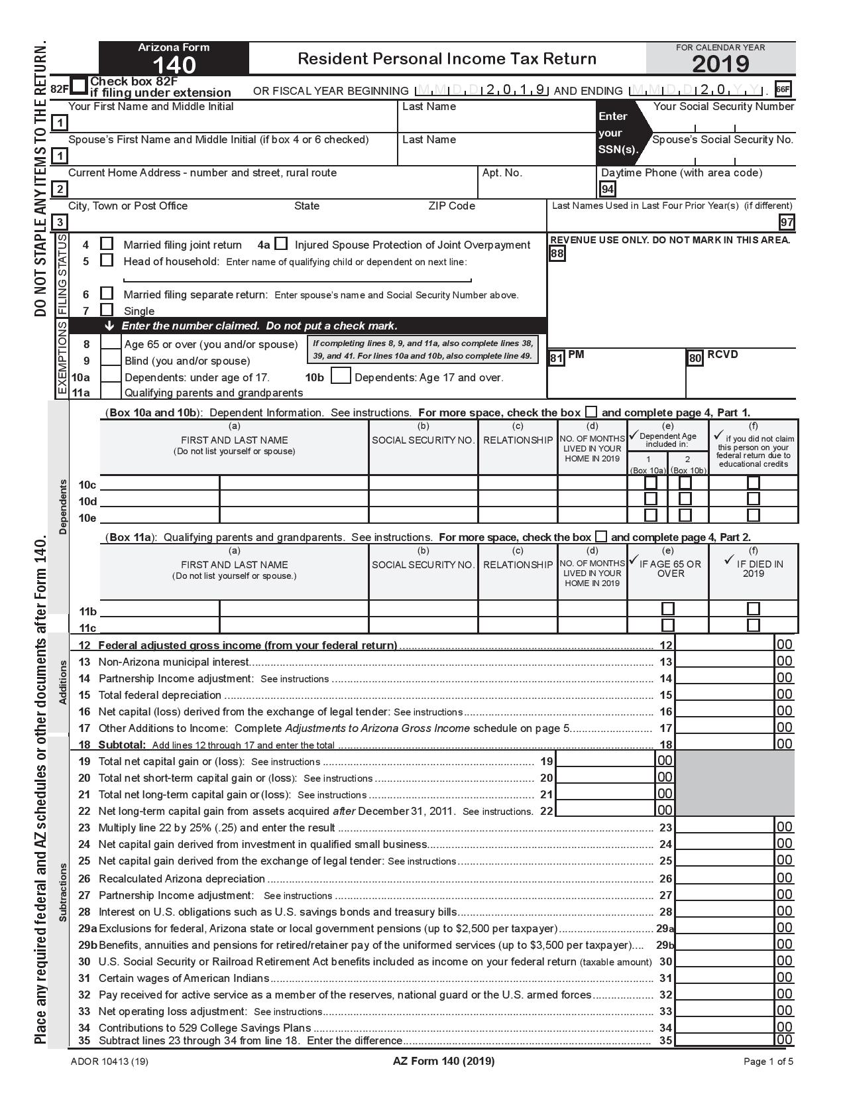
Arizona State Tax Return for TY2019

Slide 2
2019 only double benefits
IRS Notice 2019-12 (issued June 11, 2019) discusses treating charitable contributions (for which you received a state tax credit for) as state taxes paid provided the taxpayer itemizes and is under the $10,000 SALT cap.
This official federal guidance was not issued until after the close of the 2019 Arizona legislative session.
Tax Policy is aware that some taxpayers may receive a double benefit when they file their 2019 Arizona income taxes. It is possible legislation may be introduced during 2020 session to prevent taxpayers from receiving both a credit and a subtraction for the same contribution in future tax years."

Slide 3
Arizona Conformity
Tax rates - 2.59, 3.34, 4.71, 4.50
No personal exemptions
$1,500 blind exemption
$2,300 exemption for medical dependent
$2,100 over 65 exemption
Standard deductions $12,200, $18,350, $24,400 (plus 25% of charitable contributions that are not dedicated to credits)

Slide 4
Arizona Filing Status
Filing status is the same as Federal, EXCEPT:
Arizona does not have a Qualifying Widow(er) with dependent child status;
File as Head of Household on the Arizona return.

Slide 5
AZ Married HOH
When a person files HOH but is still married, we have to make the adjustment on AZ 202 manually.
TaxSlayer states they have no intention to make this manual at this time.
TaxSlayer has also removed the check box for MFS but lived with spouse during the year resulting in SS not being taxed correctly, IRA and education credits being allowed though they should not be.
This affects AZ when we have married HOH.
Blog reflects they know there is an issue but not what they intend to do to fix it.

Slide 6
Standard Deduction Indexed for Inflation
Single or married filing separate $12,200
MFJ - $24,400
HH - $18,350
25% of charitable contributions can be added to standard deductions

Slide 7
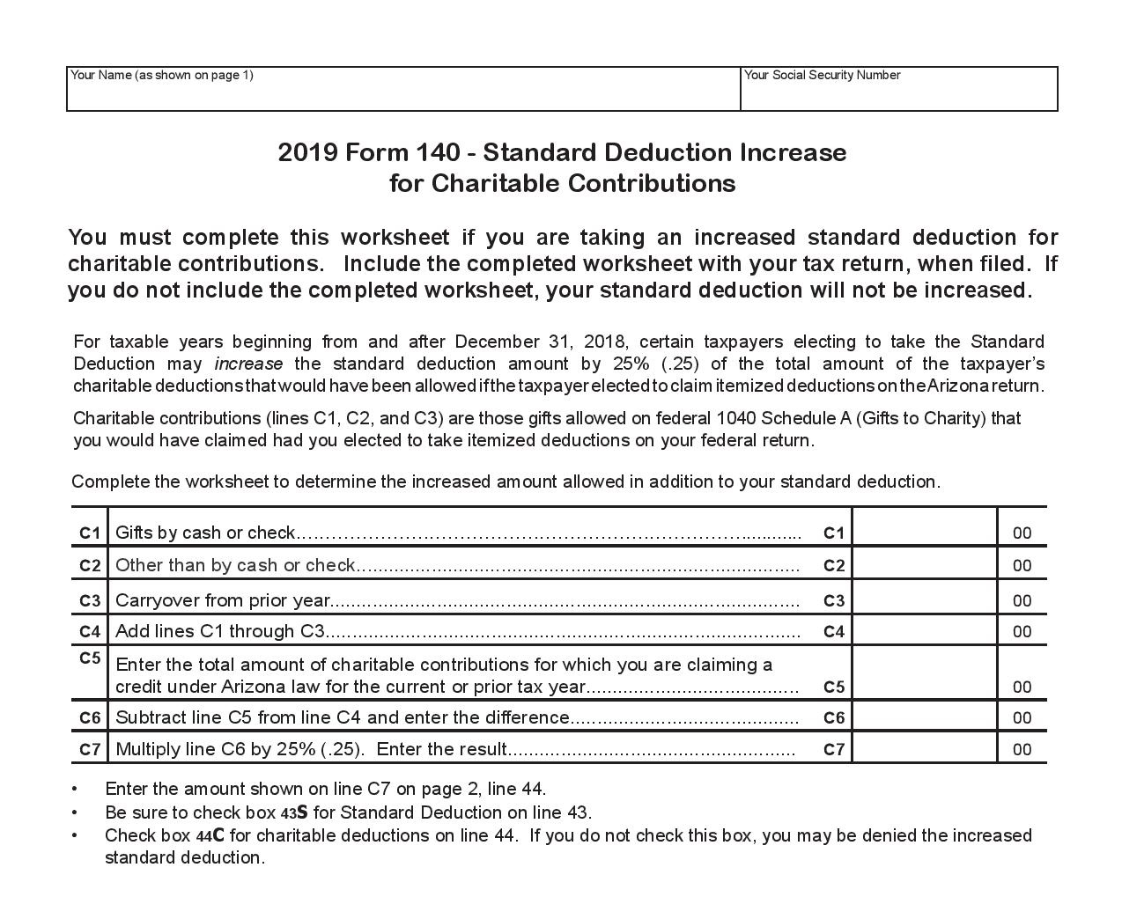
Addition to Standard Deduction

Slide 8
Arizona Filing Requirements
You must file if you are: | AND your Arizona adjusted gross income is at least: | OR your gross income is at least:
Single | $5,500 | $15,000
Married filing jointly | $11,000 | $15,000
Married filing separately | $11,000 | $15,000
Head of Household | $11,000 | $15,000

Slide 9
Personal Exemption/Credit Chart
Filing status | Exemption Amount
Single | $0
Married filing jointly | $0
Married filing jointly with dependents | $0
Head of Household – not married | $0
Head of Household – married | $0
Married filing separately – no dependents | $0
Dependent CREDIT (under 17) | $100
Dependent CREDIT (over 17) | $25
Ancestor exemption | $10,000
Reduced for AGI > $200,000/$400,000

Slide 10
Arizona Income
If you are an Arizona resident, you must report income from all worldwide sources.
Arizona law does not tax:
Interest from U.S. Government obligations
Social Security retirement benefits received under Title II of the Social Security Act
Benefits received under the Railroad Retirement Act
Active duty military pay
Active duty reserve or National Guard pay

Slide 11
TaxSlayer Arizona Adjustments
Dependents - add'l and qualifying ancestors
Additions to income
Non AZ munis, partnership income, etc
Subtractions from income
US bond interest, Qualified pension $2,500 exclusion, $3,500 uniform service retirement pay, ALL SS/RRB, Some military pay, 529 plans, etc
Credits
321, 322, 323, 348, 352, 309, etc.
AZ Itemized Deductions
Adjust for credits, etc.

Slide 12
Arizona Form 203
Injured Spouse Protection
Beginning in 2017, Arizona allows an injured spouse protection
Injured spouse's share is protected from:
Past due state taxes
Child Support
Spousal Maintenance
Other court or state agency ordered obligations
Injured spouse's protected share is proportional to percentage of tax paid by that spouse
Check box 4a and place form 203 on top of the Arizona return

Slide 13
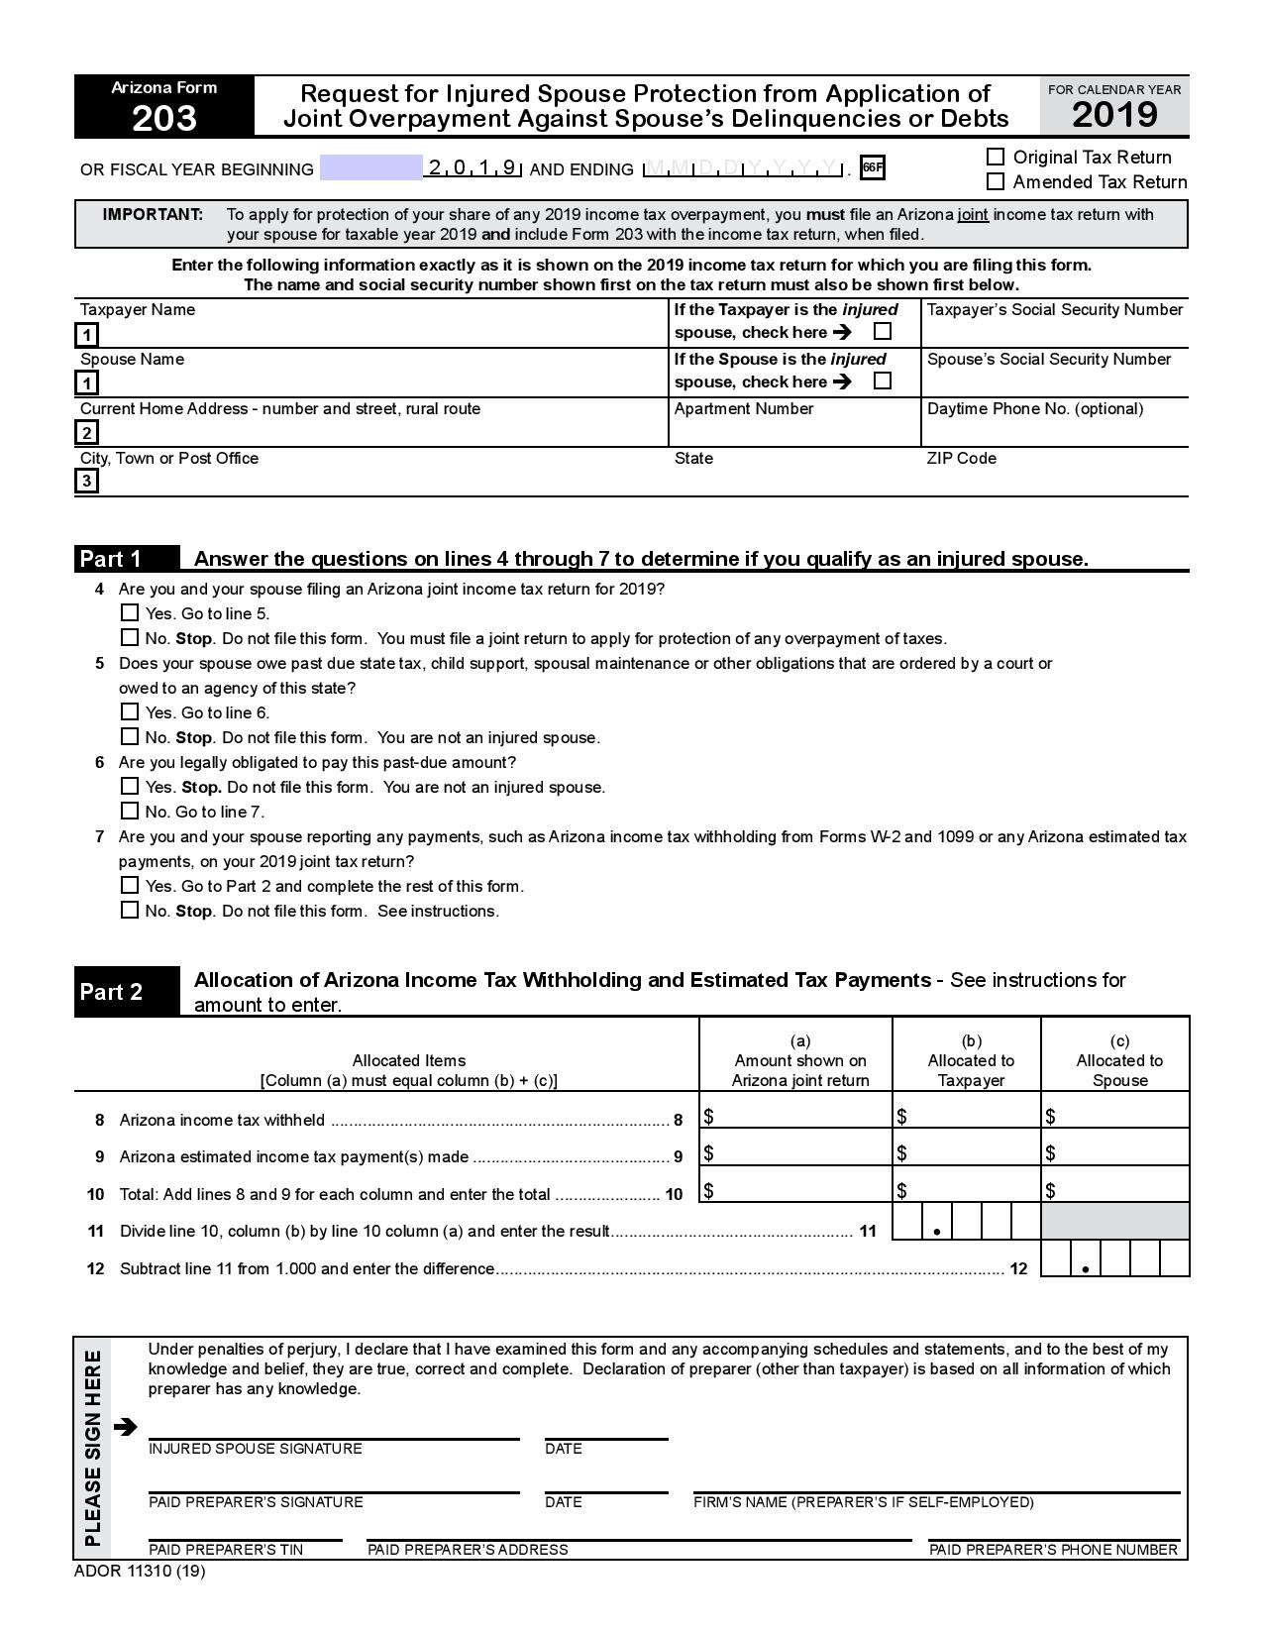

Slide 14
Standard Deduction for Children Claimed as Dependents
On the Arizona return:
A dependent child can claim a standard deduction even if his or her parents can claim the child as a dependent on their Arizona tax return

Slide 15
Arizona Personal Exemptions
On the Arizona return, the taxpayer can take a dependent credit for a stillborn child if:
The stillbirth occurred during 2019
The taxpayer received a certificate of stillbirth from the Arizona DHS
The child would have been a member of the taxpayer’s household
On the Arizona return, the taxpayer can take an credit for dependents over 65 who are not exemptions on the Federal return if in 2019:
You paid more than 25%, but at least $800 of the cost of keeping this person in an Arizona residential care institution or assisted living facility
You paid more than $800 for Arizona medical costs or home health care for the person

Slide 16
Qualifying Ancestor Exemption
Arizona residents may claim a $10,000 exemption for each qualifying parent and ancestor.
The taxpayer’s parent or the taxpayer’s parent’s ancestor (grand parent, great grand parent, etc.)
If married filing a joint return, the spouse’s parent or an ancestor of the spouse’s parent
You cannot claim the same person as your ancestor and your dependent

Slide 17
Qualifying Ancestor Exemption
You may claim this exemption if ALL of the following apply:
The ancestor lived in your principal residence for the entire taxable year.
You paid more than one-half of the support and maintenance costs of the ancestor during the entire year.
The ancestor was 65 years old or older during 2019.
The ancestor required assistance with at least 2 activities of daily living, such as: getting in and out of bed or chairs, walking around, going outdoors, using the toilet, bathing, shaving, brushing teeth, combing hair, dressing, medicating or feeding.

Slide 18
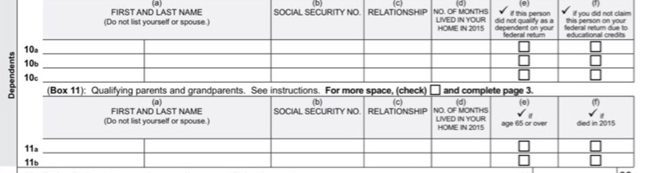
Modifying Dependent Information for Arizona
On line 10, enter the following.
The names of any dependents age 65 or over that you cannot take as a dependent on your federal return.
The name of any stillborn child. Also enter the date of the stillbirth.
The name of any student, that you did not claim as an exemption on your federal return in order to allow that student to claim a federal education credit.
On line 11, enter the name of any Qualifying Ancestors and remove from Line 10

Slide 19
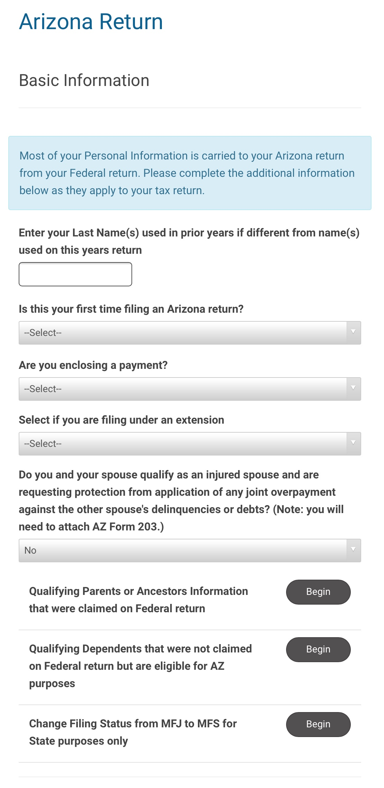

Slide 20
AZ tax information entered as part of TaxSlayer Federal entries
AZ interest income
AZ tax exempt interest
AZ state interest adjustment
W-2 gambling winnings

Slide 21
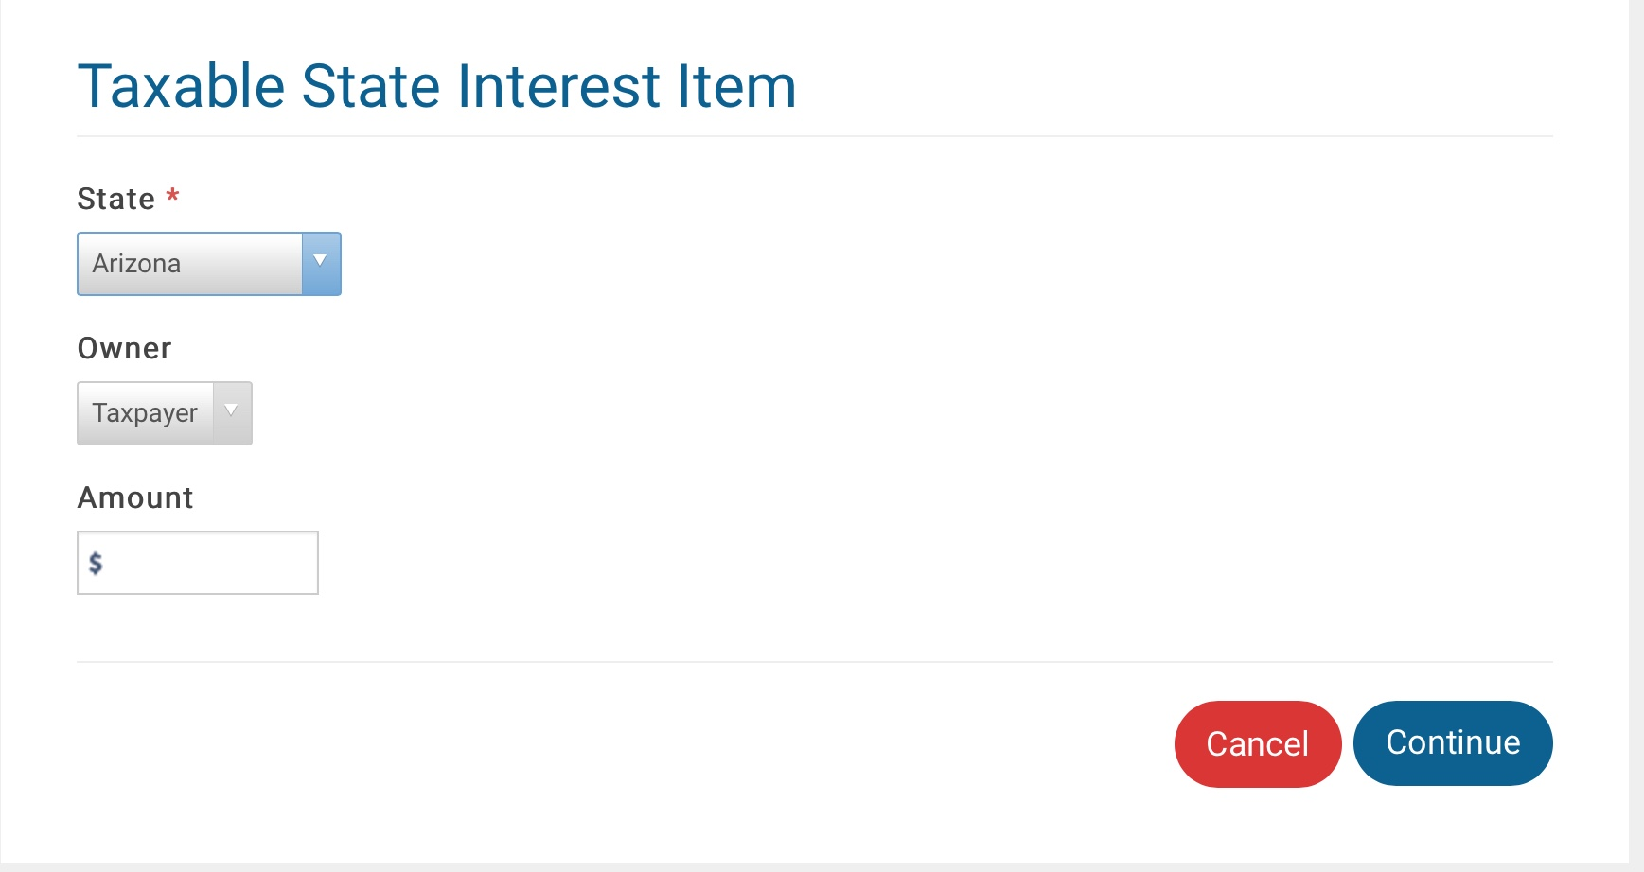
AZ taxable state interest adjustment

Slide 22
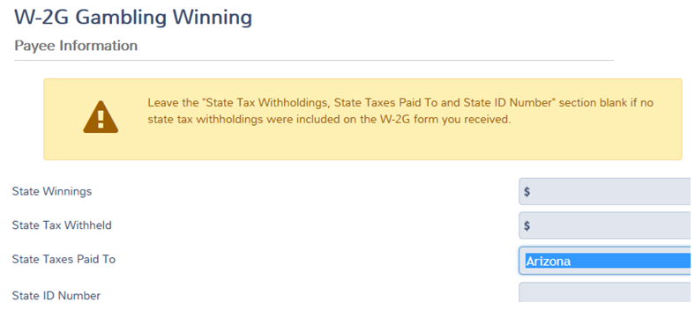
W-2G Gambling Winnings

Slide 23
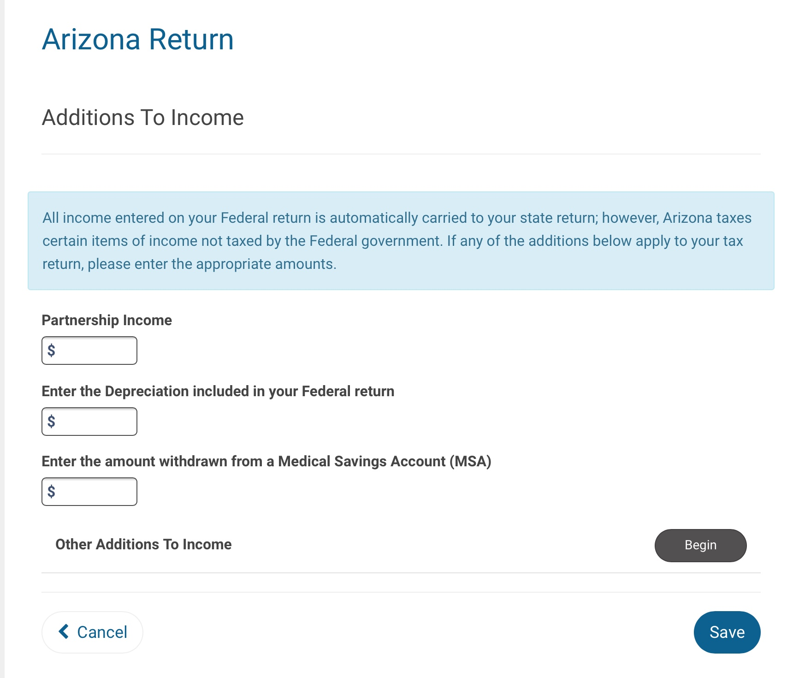
TS Additions to Income

Slide 24
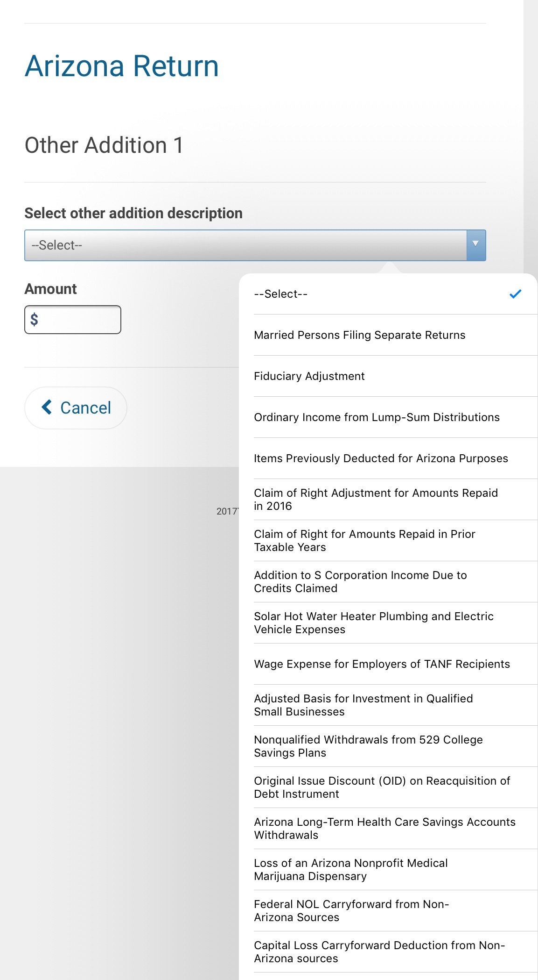
Additions to Federal Adjusted Gross Income

Slide 25
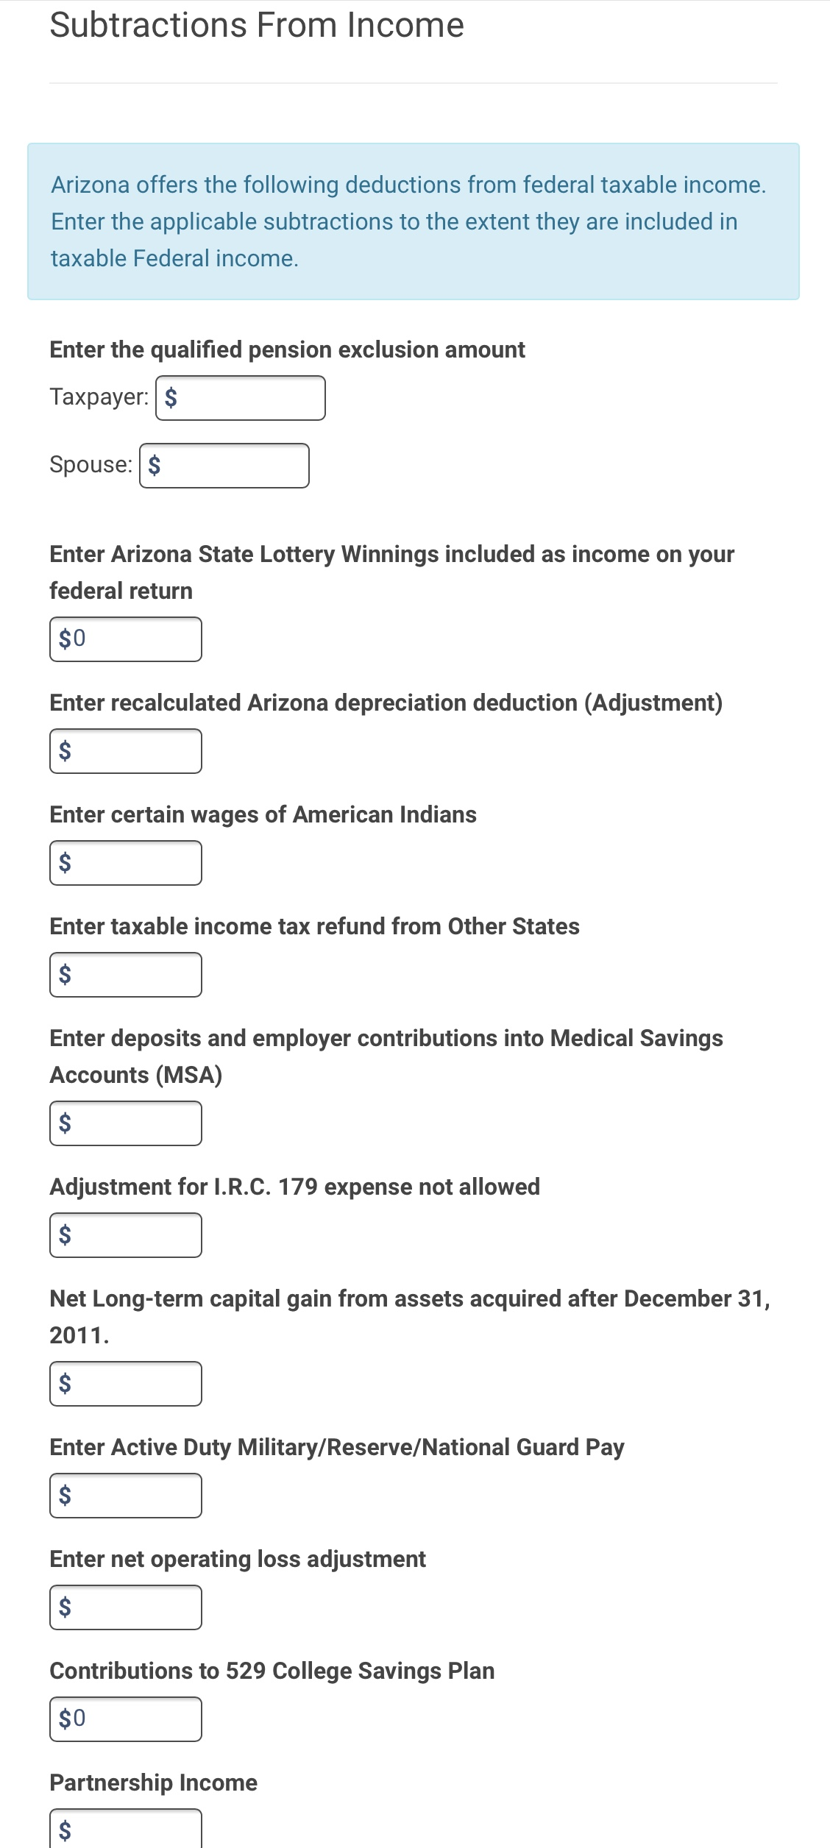
TaxSlayer Subtractions from Federal Adjusted Gross Income

Slide 26
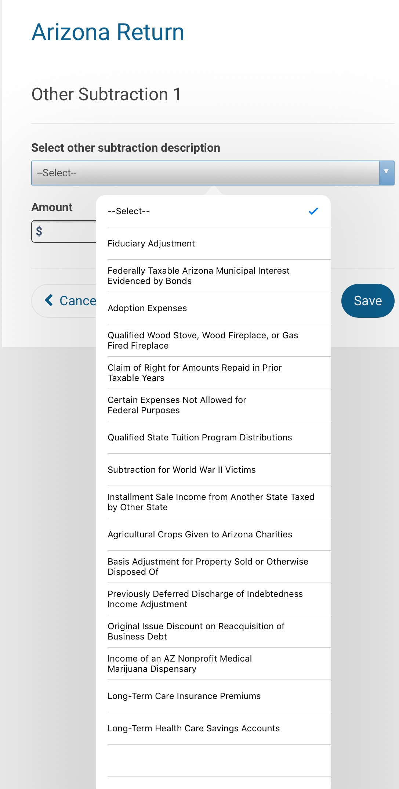
Other Subtractions from Federal Adjusted Gross Income

Slide 27
Schedule A Itemized Deduction Adjustments
You must complete Form 140, Schedule A, ONLY if any of the following items apply:
Deducting medical/dental expenses
Claiming a Federal Credit – form 8396 – for interest paid on Mortgage Credit Certificates
Claimed deductions on the Federal Sch A of expenses related to income not subject to AZ tax
Claiming an AZ Credit for any amount allowed as a charitable contribution

Slide 28
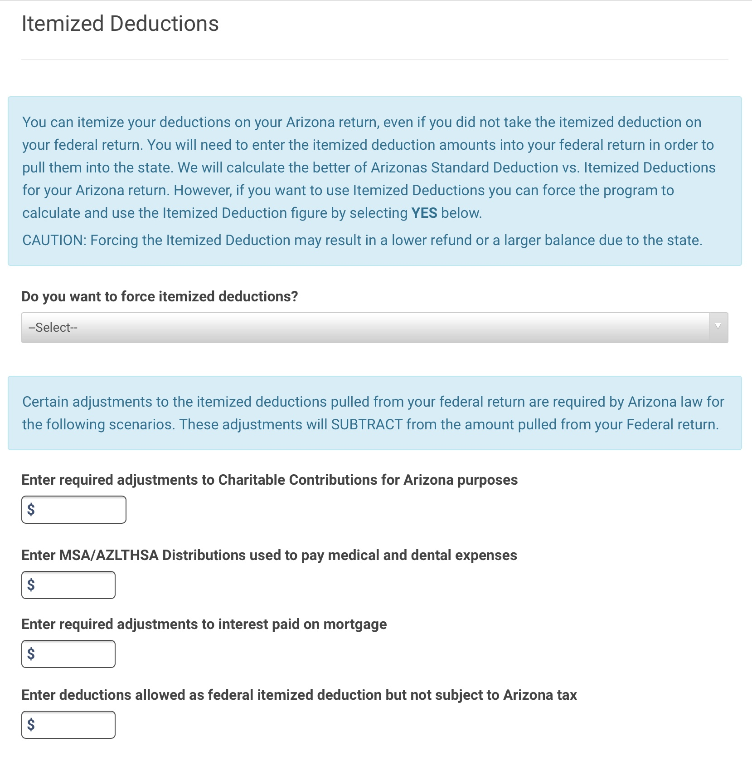
TaxSlayer Adjustments to Itemized Deductions

Slide 29
Subtraction for Long-Term Care Insurance Premiums
You may subtract the amount of qualifying premium costs for long-term care insurance only if you are not claiming itemized deductions.

Slide 30
Subtraction for AZ Long-Term Health Care Savings Accounts
You may subtract amounts you paid into long-term health care savings account established under AZ law

Slide 31
Subtraction for 529 College Savings Plans
Single or HH - $2,000
MFJ - $4,000

Slide 32
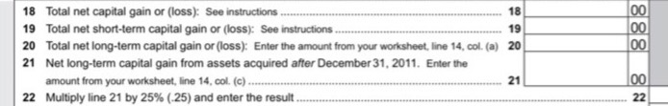
Subtraction for Net Long-Term Capital Gains
You may take a subtraction from AZ gross income for a percentage of any net long-term capital gain included in AGI derived from assets acquired after 12/31/11
Complete a worksheet included in the tax form to take this subtraction

Slide 33
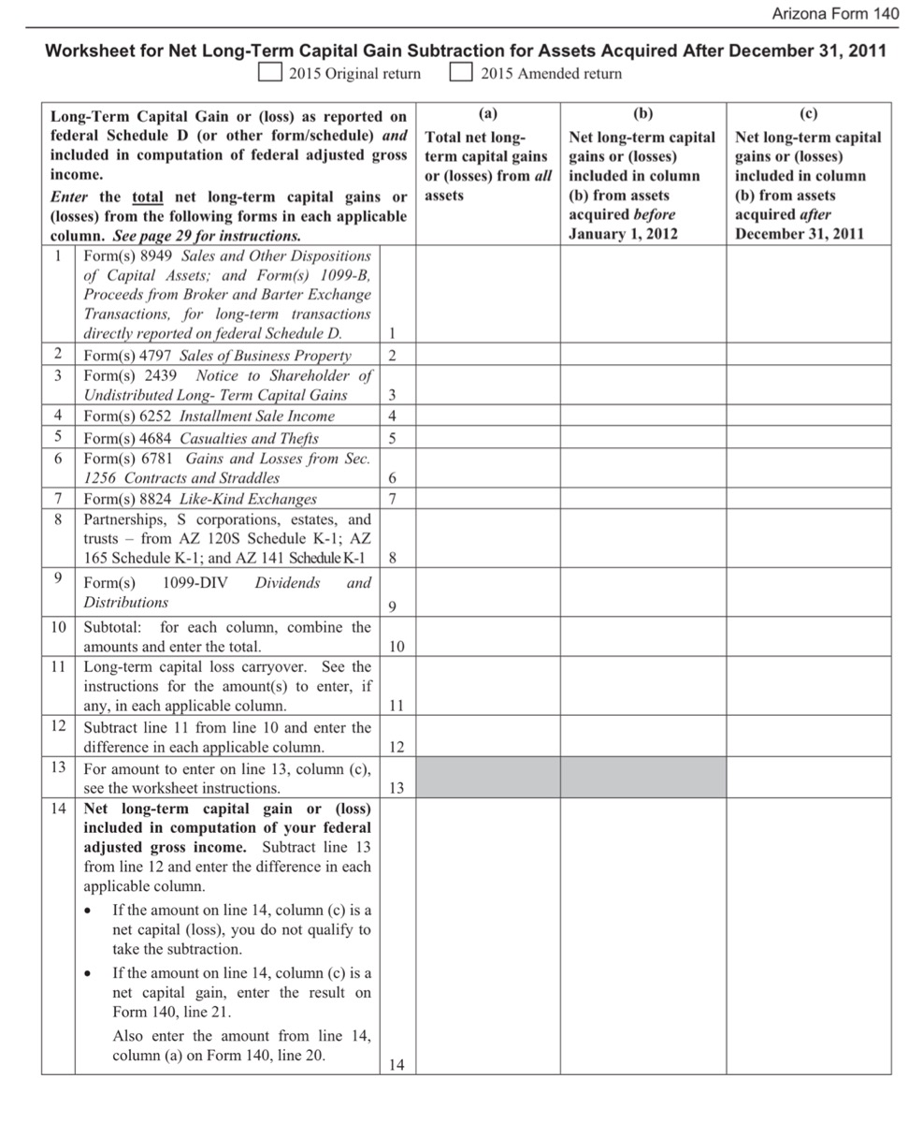

Slide 34
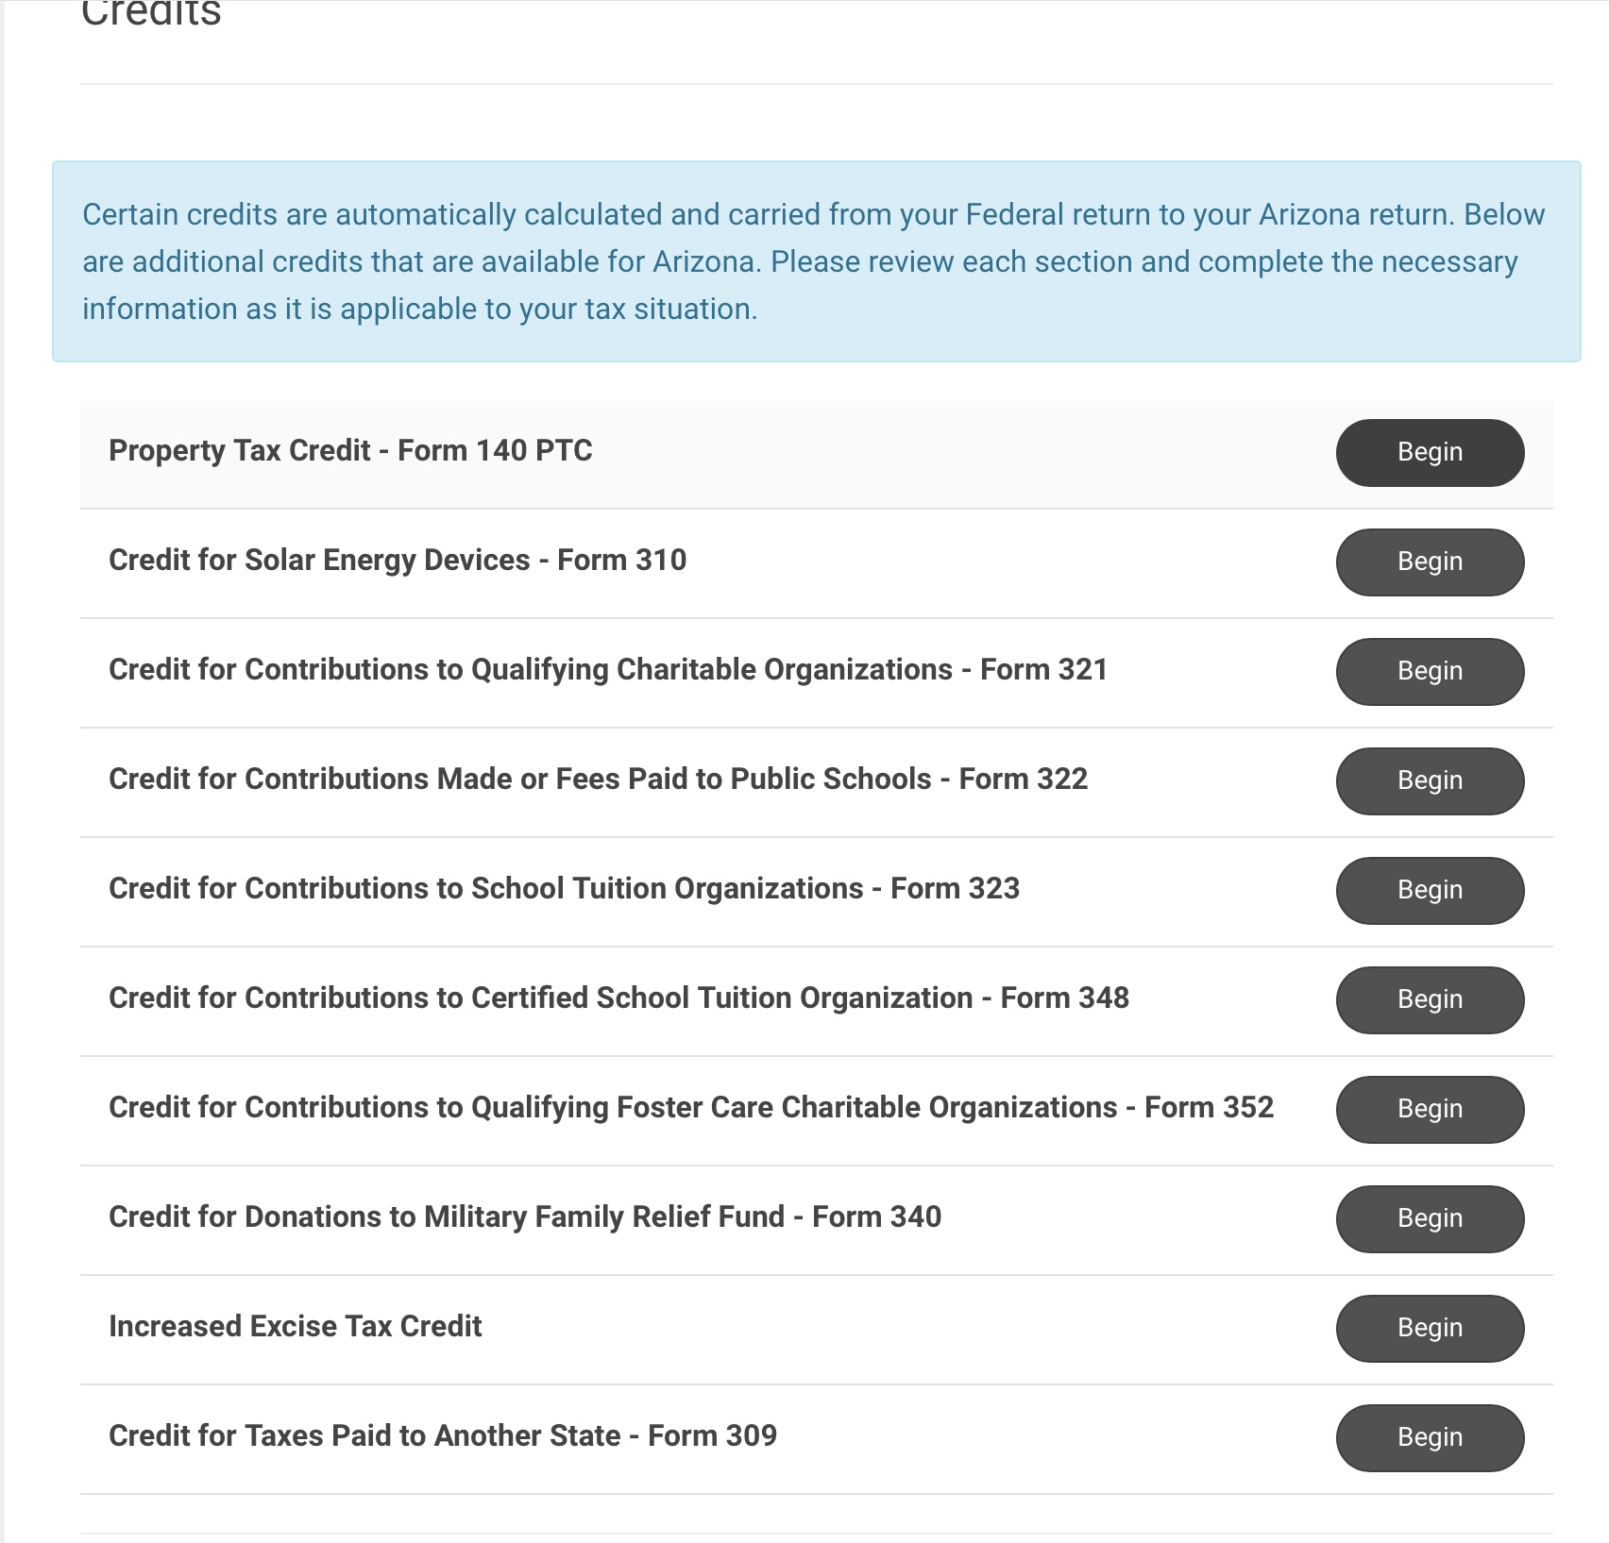
TaxSlayer AZ Credits

Slide 35
Property Tax Credit – Form 140 PTC
Resident for entire year
65 or older by 12/31/2019 or received SSI Title 16
Total household income < $3,751 if you lived alone or <$5,501 if others lived with you (Capital losses from previous years do not reduce household income)
You paid property tax or rent on your main home
You must attach form 201 if a renter and/or
Proof of tax paid if an owner

Slide 36
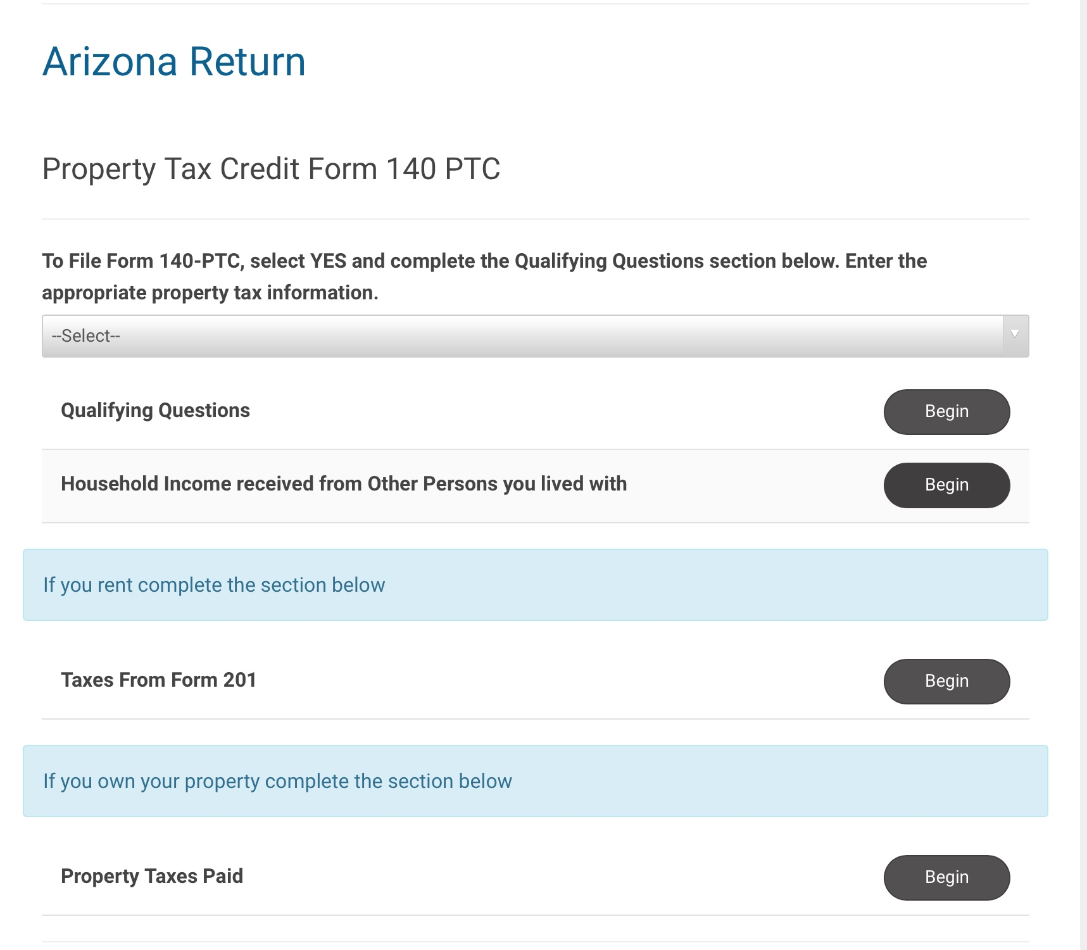
AZ property tax credit

Slide 37
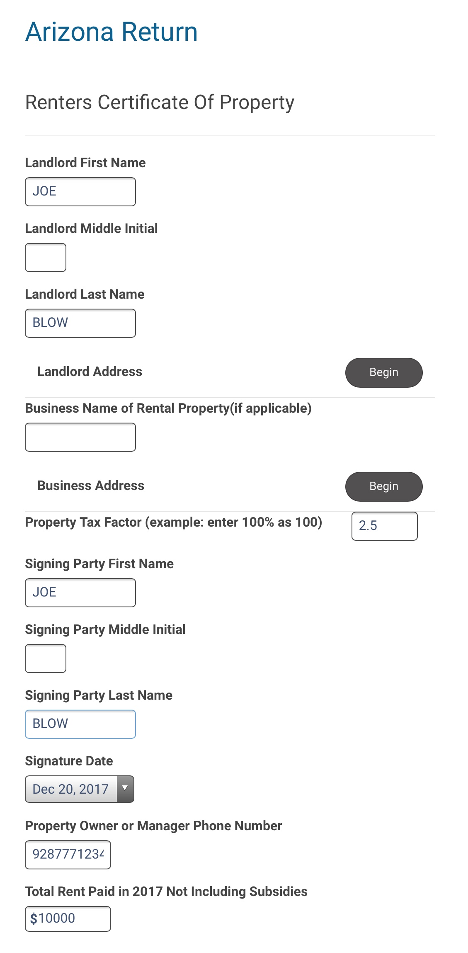
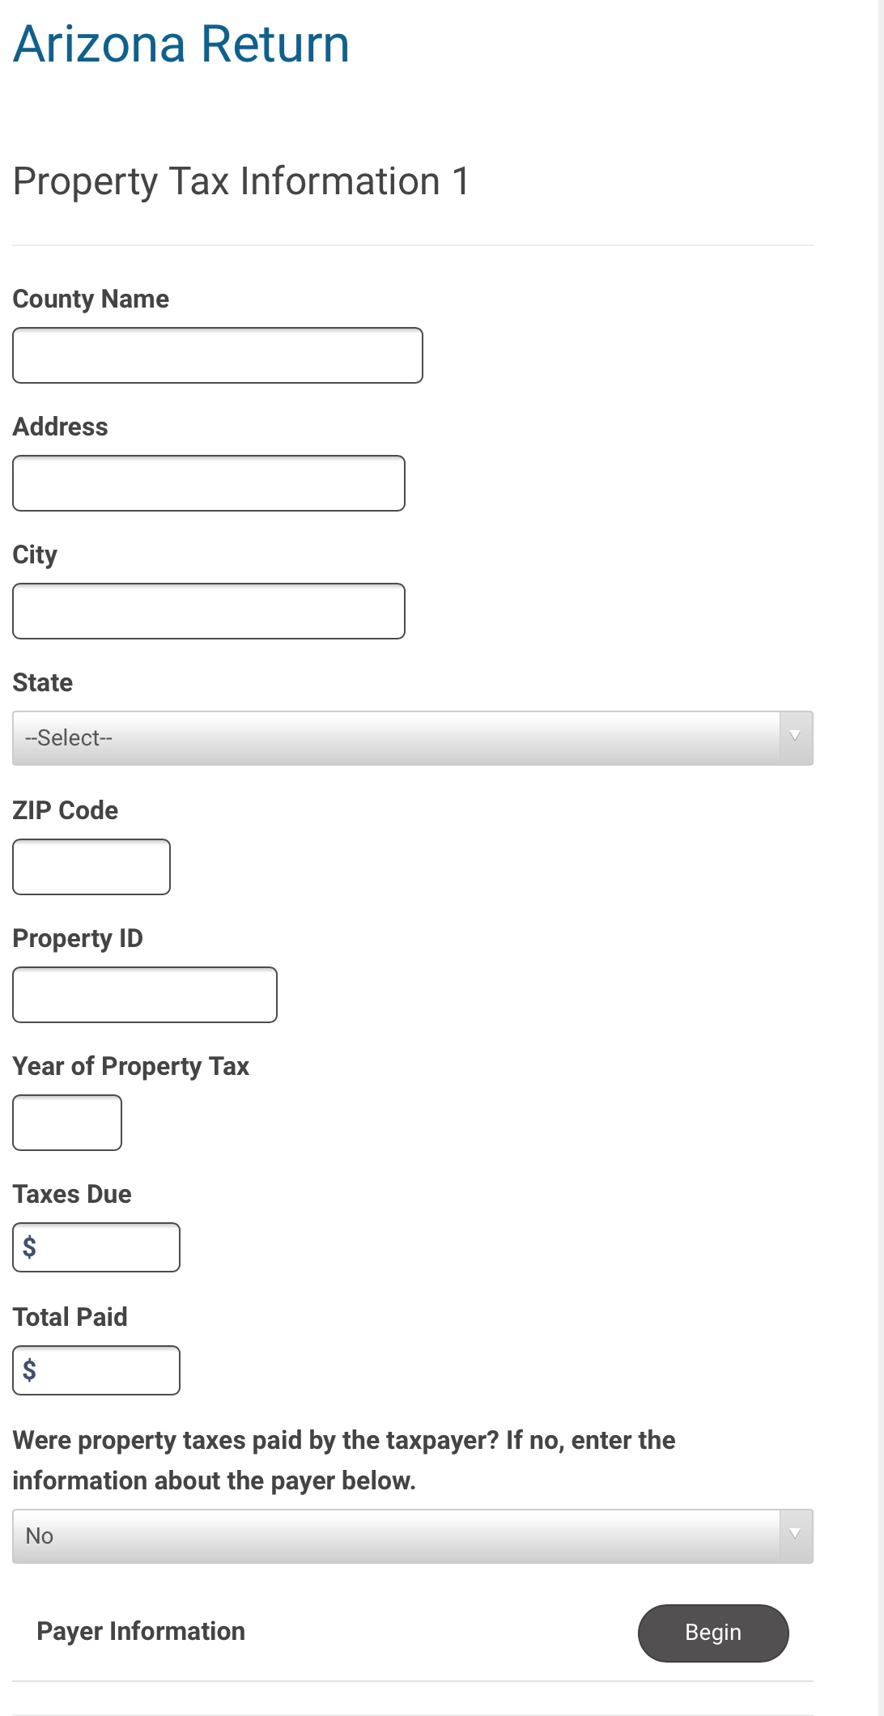

Slide 38
Form 140ET
Credit for increased excise tax
Arizona resident during 2019
Not claimed as a dependent
Not sentenced to prison for > 59 days of 2019
Federal AGI
$25,000 or less if MFJ or HOH
$12,500 or less if single
$12,500 or less if MFS

Slide 39
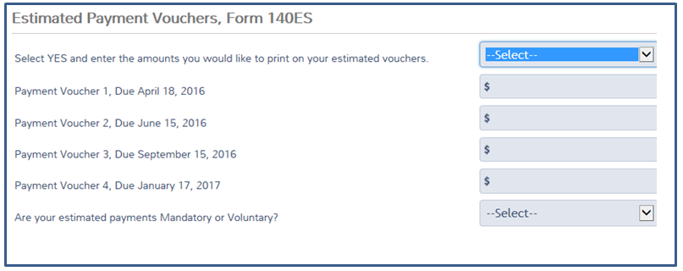
Estimated payments Form 140ES

Slide 40
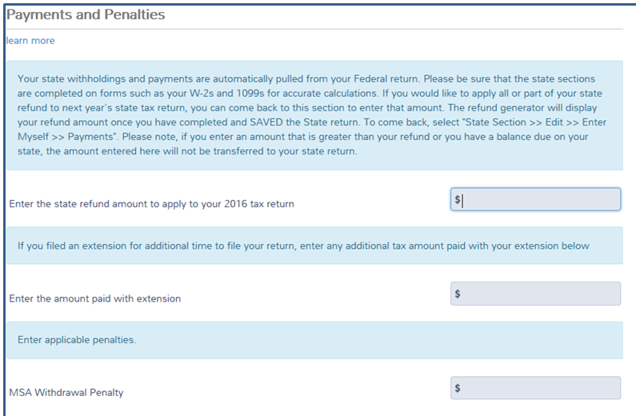

Slide 41
AZ Form 301
AZ Form 301 is only a Recapture of all the Nonrefundable Credits

Slide 42
Credit Type | Form | Single Max | MFJ Max
Credit recapture form | Form 301
Taxes paid to another state or country on the same income | Form 309
Contributions to Qualifying Charitable Organizations | Form 321 | $400 | $800
Contributions Made or Fees Paid to Public Schools | Form 322 | $200 | $400
Contributions to Private School Tuition Organizations | Form 323 | $569 | $1138
Credit for Contributions to Military Family Relief Fund | Form 340 | $200 | $400
Contributions to Certified School Tuition Organizations | Form 348 | $566 | $1131
Contributions to Qualifying Foster Care Organizations | Form 352 | $500 | $1000

Slide 43
Arizona Form 321
Credit for Contributions to Qualifying Charitable Organizations (QCO)
Beginning in 2018 the 5 digit code for each QCO must be entered.
Donations may be made until 4/15/20 for tax year 2019
If the allowable tax credit is more than your tax or if you have no tax, you may carry the unused credit forward for up to the next 5 years

Slide 44
Credit for Contributions to Qualifying Charitable Organizations
Taxpayers are able to make cash contributions to a Qualifying Foster Care Charitable Organization (QFCO) with the 352 credit

Slide 45
Qualified Foster Care Organizations (QFCO)
To become a QFCO, the organization must first meet all requirements to be a QCO. 5 digit code req'd
In addition a QFCO must:
Provide services to at least 200 children in Arizona
Spend at least 50% of its budget on services to foster children in Arizona
Services include: cash assistance, medical care, child care, food, clothing, shelter, job placement and job training services or any other assistance that is reasonably necessary to meet immediate basic needs.

Slide 46
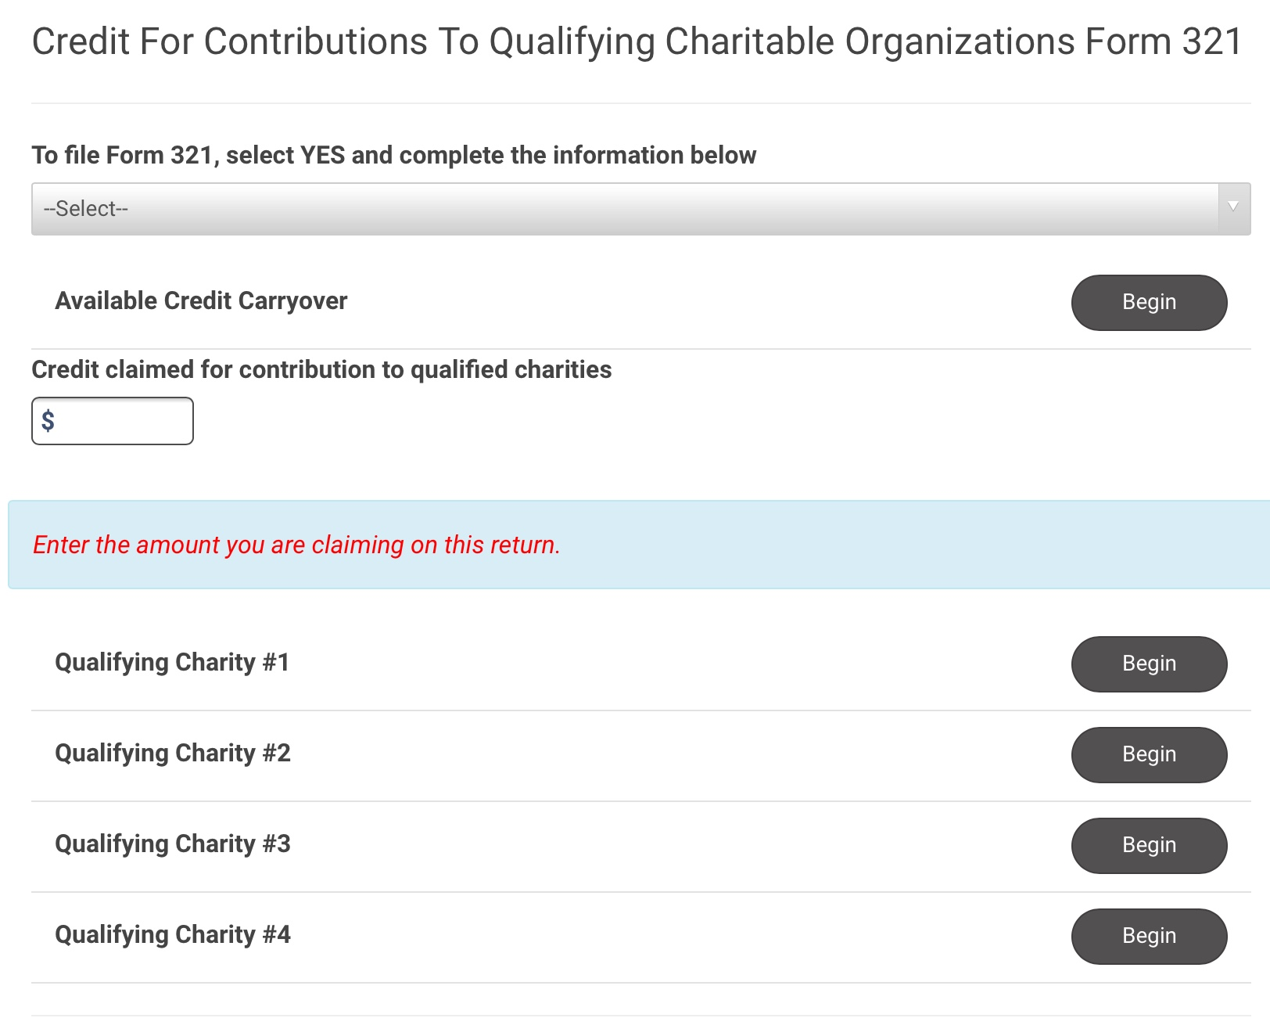
TS AZ Form 321 credits

Slide 47
Arizona Form 322
Credit for Contributions Made or Fees Paid to Public Schools
Beginning in 2018 the 9 digit code for the school must be included.
If the allowable tax credit is more than your tax or if you have no tax, you may carry the unused credit forward for up to the next 5 years.
To qualify for the credit, you must make contributions or pay fees to a public school for support of extra curricular activities or for character education programs.
Donations may be made until 4/15/20 for tax year 2019

Slide 48
Arizona Form 322
Extra curricular activities may include:
The following do not qualify for this credit:
use of band uniforms
use of equipment or uniforms for varsity athletics
use of scientific laboratory equipment or materials
in state or out-of-state trips that are solely for competitive events
All day kindergarten
a nongovernmental school
a pre-school
a community college
a university
a public school located outside of Arizona

Slide 49
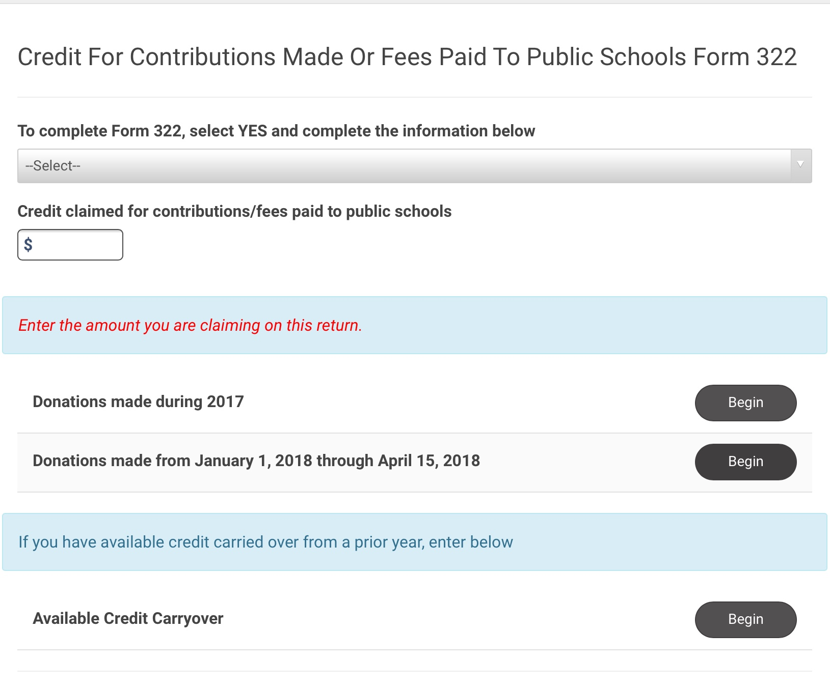
TS AZ Form 322 credits

Slide 50
Arizona Form 323
Credit for Contributions to School Tuition Organizations
If the allowable tax credit is more than your tax or if you have no tax, you may carry the unused credit forward for up to the next 5 years.
Donations may be made until 4/15/20 for tax year 2019
A school tuition organization is an organization that meets all of the following:
Tax exempt under Section 501(c) (3) of the Internal Revenue Code.
Allocates at least 90 percent of its annual revenue to scholarships or grants.
Scholarships or grants available to students of more that one qualified school.

Slide 51
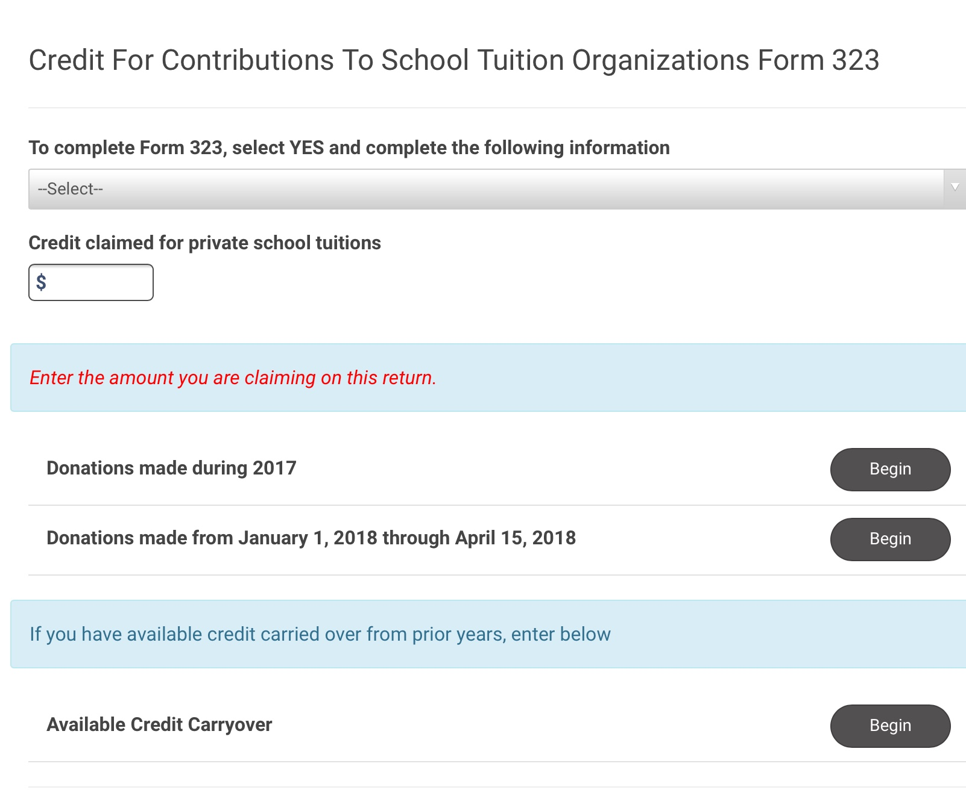
AZ Form 323 credits

Slide 52
Arizona Form 348
Credit for Contributions to Certified School Tuition Organizations
This is in addition to credit from AZ Form 323 if you exceed the allowable credit amount on AZ 323
IN TAXSLAYER - enter the total Tuition contributions into BOTH the 323 and the 348

Slide 53
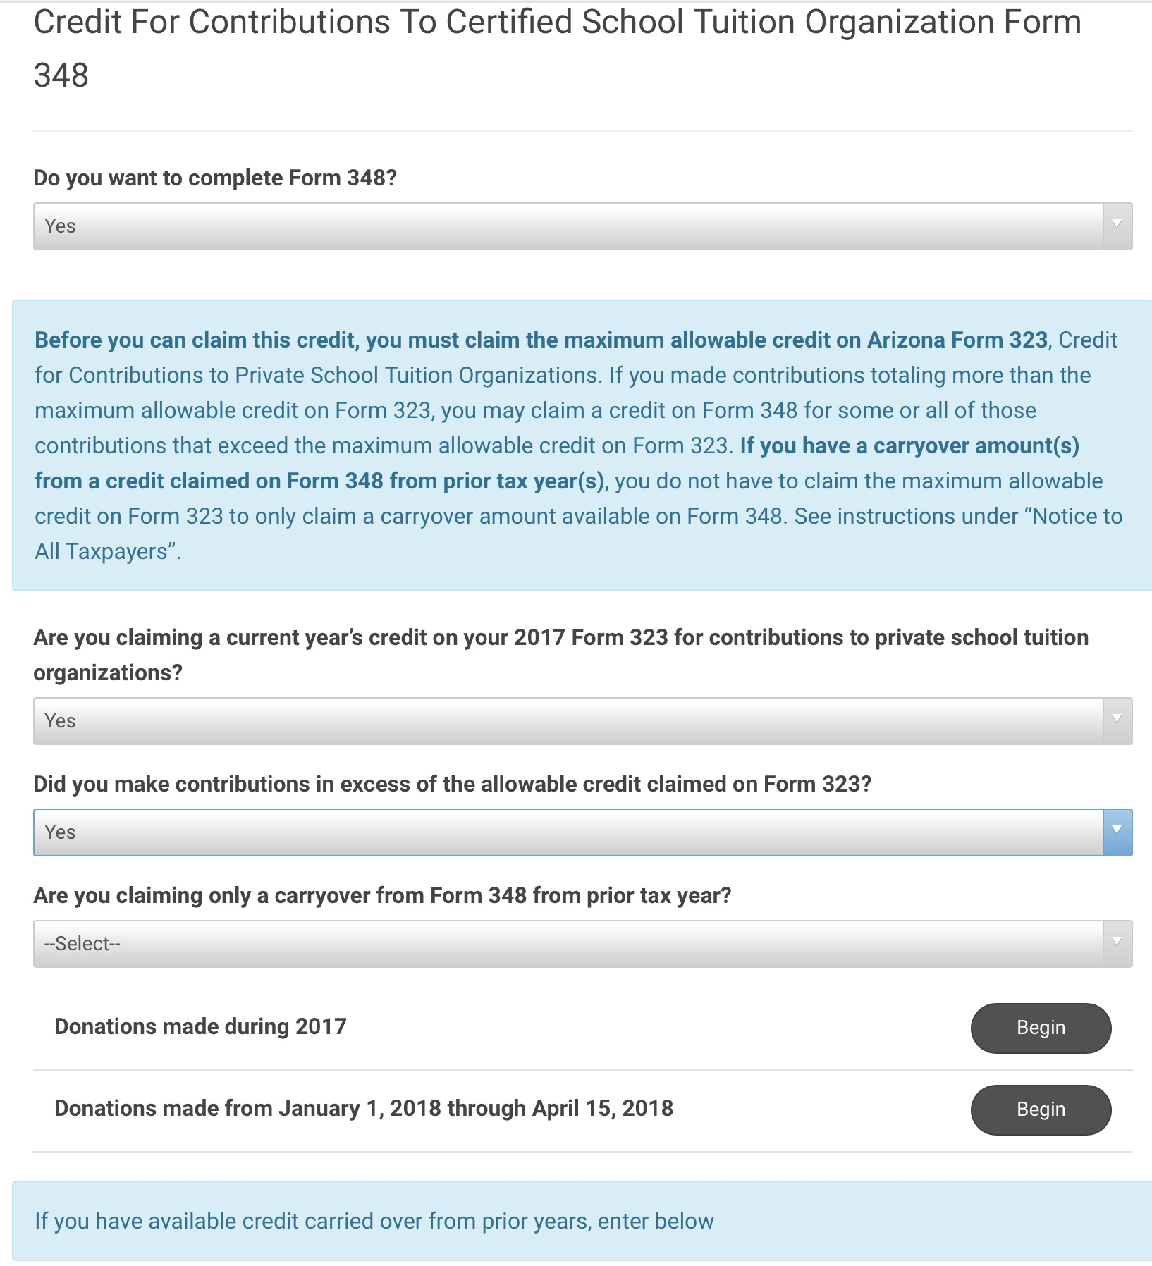
348 Credits

Slide 54
Arizona Form 309
Arizona residents are allowed a credit to income taxes paid to another state or country if :
The income taxed in Arizona is derived from sources within another state or country that is subject to tax in the other state or country regardless of your residence.
The other state or country does not allow Arizona residents a credit for taxes imposed on income subject to tax in both Arizona and the other state or country.
The other state or country return must be attached. If not required, proof of the withholding must be attached.
As an Arizona resident, nonresident returns filed with the following states qualify for the credit:
Alabama, Arkansas, Colorado, Connecticut, Delaware, Georgia, Hawaii, Idaho, Illinois, Iowa, Kansas, Kentucky, Louisiana, Maine, Maryland, Massachusetts, Michigan, Minnesota*, Mississippi, Missouri, Montana, Nebraska, New Jersey, New Mexico, New York, North Carolina, North Dakota, Ohio, Oklahoma, Pennsylvania, Rhode Island, South Carolina, Utah, Vermont, West Virginia and Wisconsin.

Slide 55
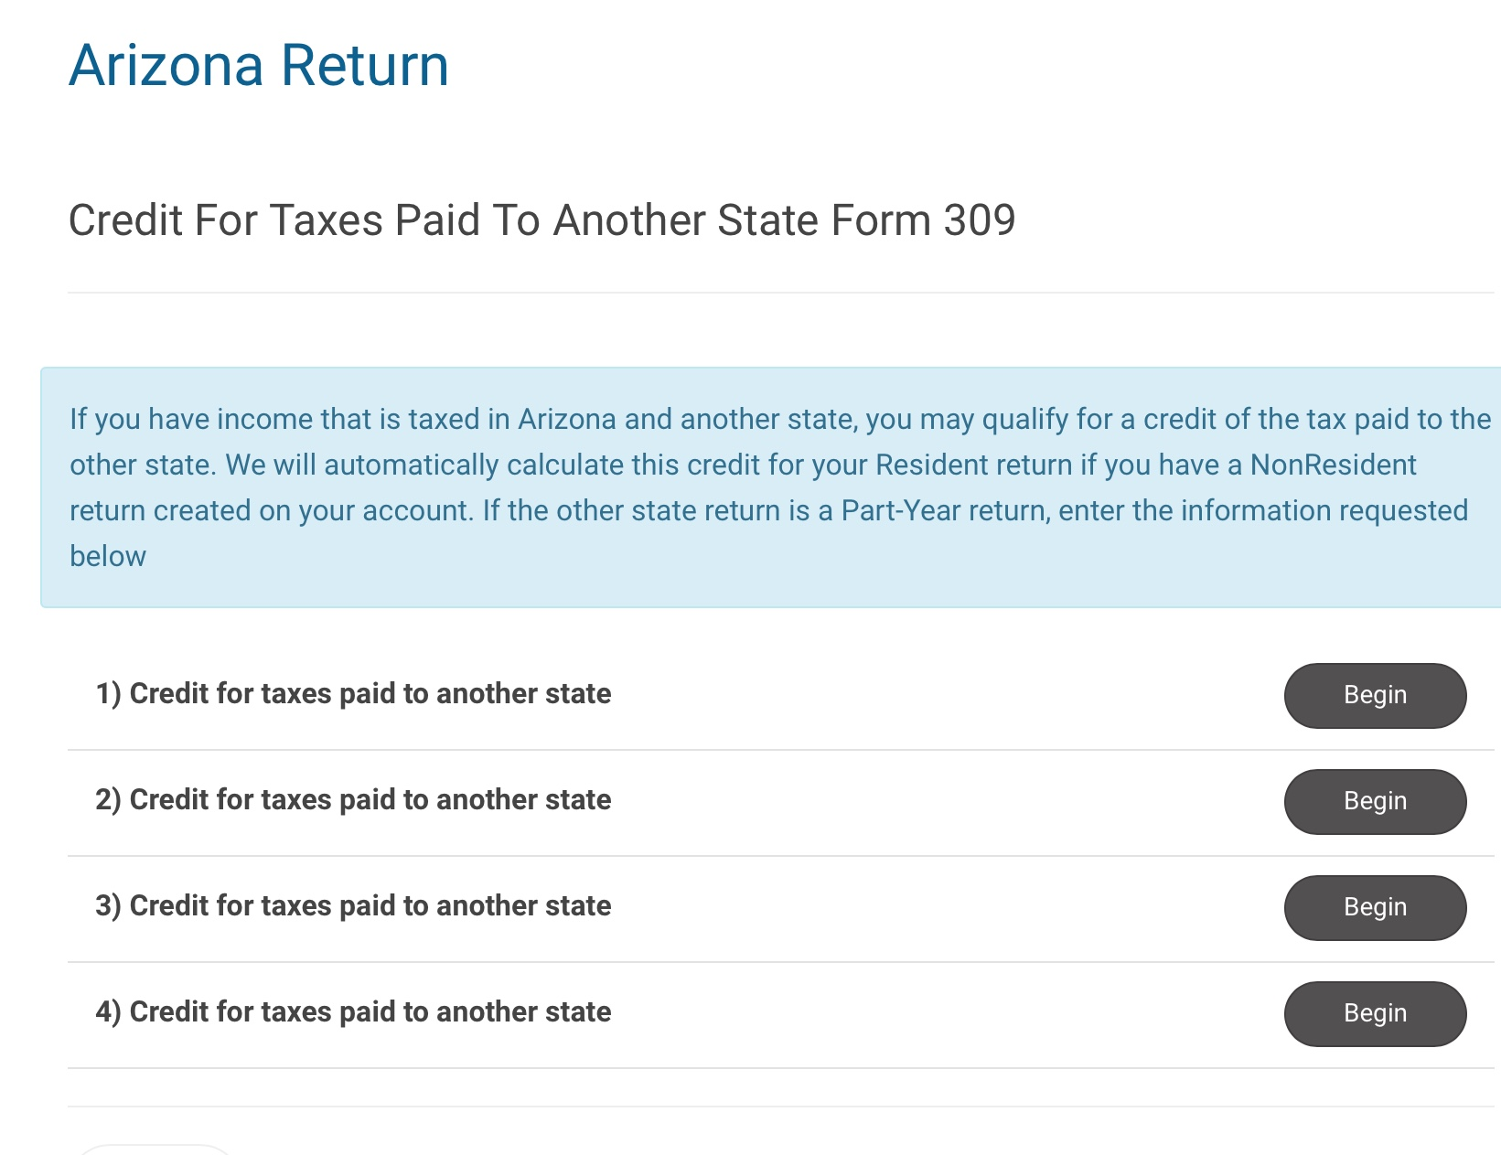
Credits for taxes paid to another state or country

Slide 56
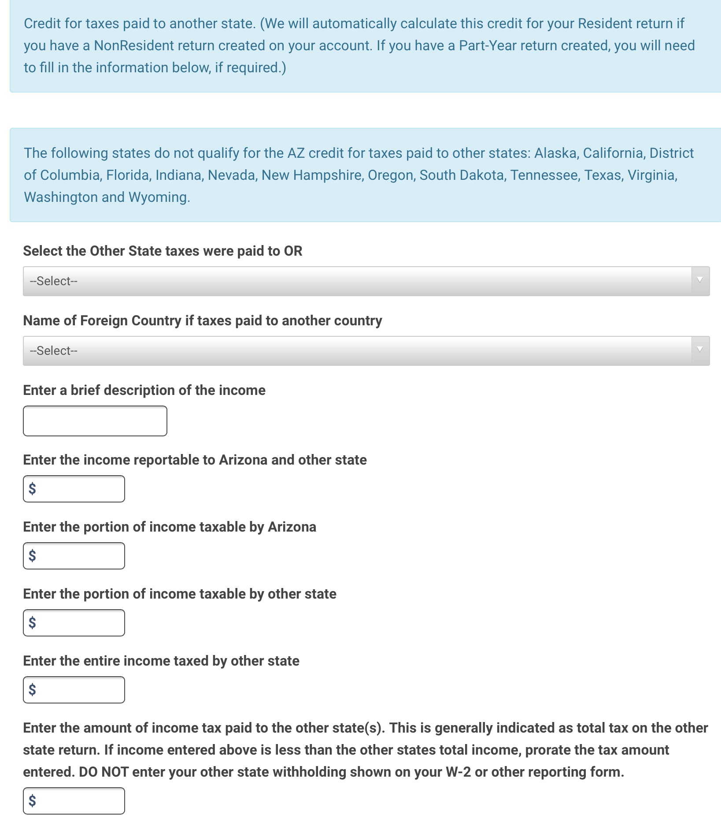
309 Credits

Slide 57
Arizona Form 340
Credit for Contributions to Military Family Relief Fund
You must receive a receipt from the Arizona Department of Veterans’ Services that indicates that your contribution qualifies for this credit.
Credit maximum is $200 S/HOH, $400 M
The fund has been separated into pre 9/11 and post 9/11 accounts.
There is no carryforward for this credit

Slide 58
Taxation of Native Americans
Interest & Dividend Payments
Not included in Arizona income even if the bank is located off the reservation.
Per Capita Payments (payments to Native Americans by their tribe)
Not taxable if living on the reservation.
Per Capita Payments to Dependents
Not taxable for Dependents living temporarily off the reservation, such as students at college, if the dependent’s parents live on the reservation, and the dependent’s home is located on that reservation.
Gambling Winnings
Not included in Arizona income if the casino is on the tribal member’s reservation, the tribe owns the casino, and the tribal member lives on the reservation.

Slide 59
Taxation of Native Americans
As a Native American, you must file an Arizona Income Tax return unless all of the following apply:
1. You are an enrolled member of an Indian tribe,
2. You live on the reservation established for that tribe,
3. You earned all of your income on that reservation.

Slide 60
